Slide 1
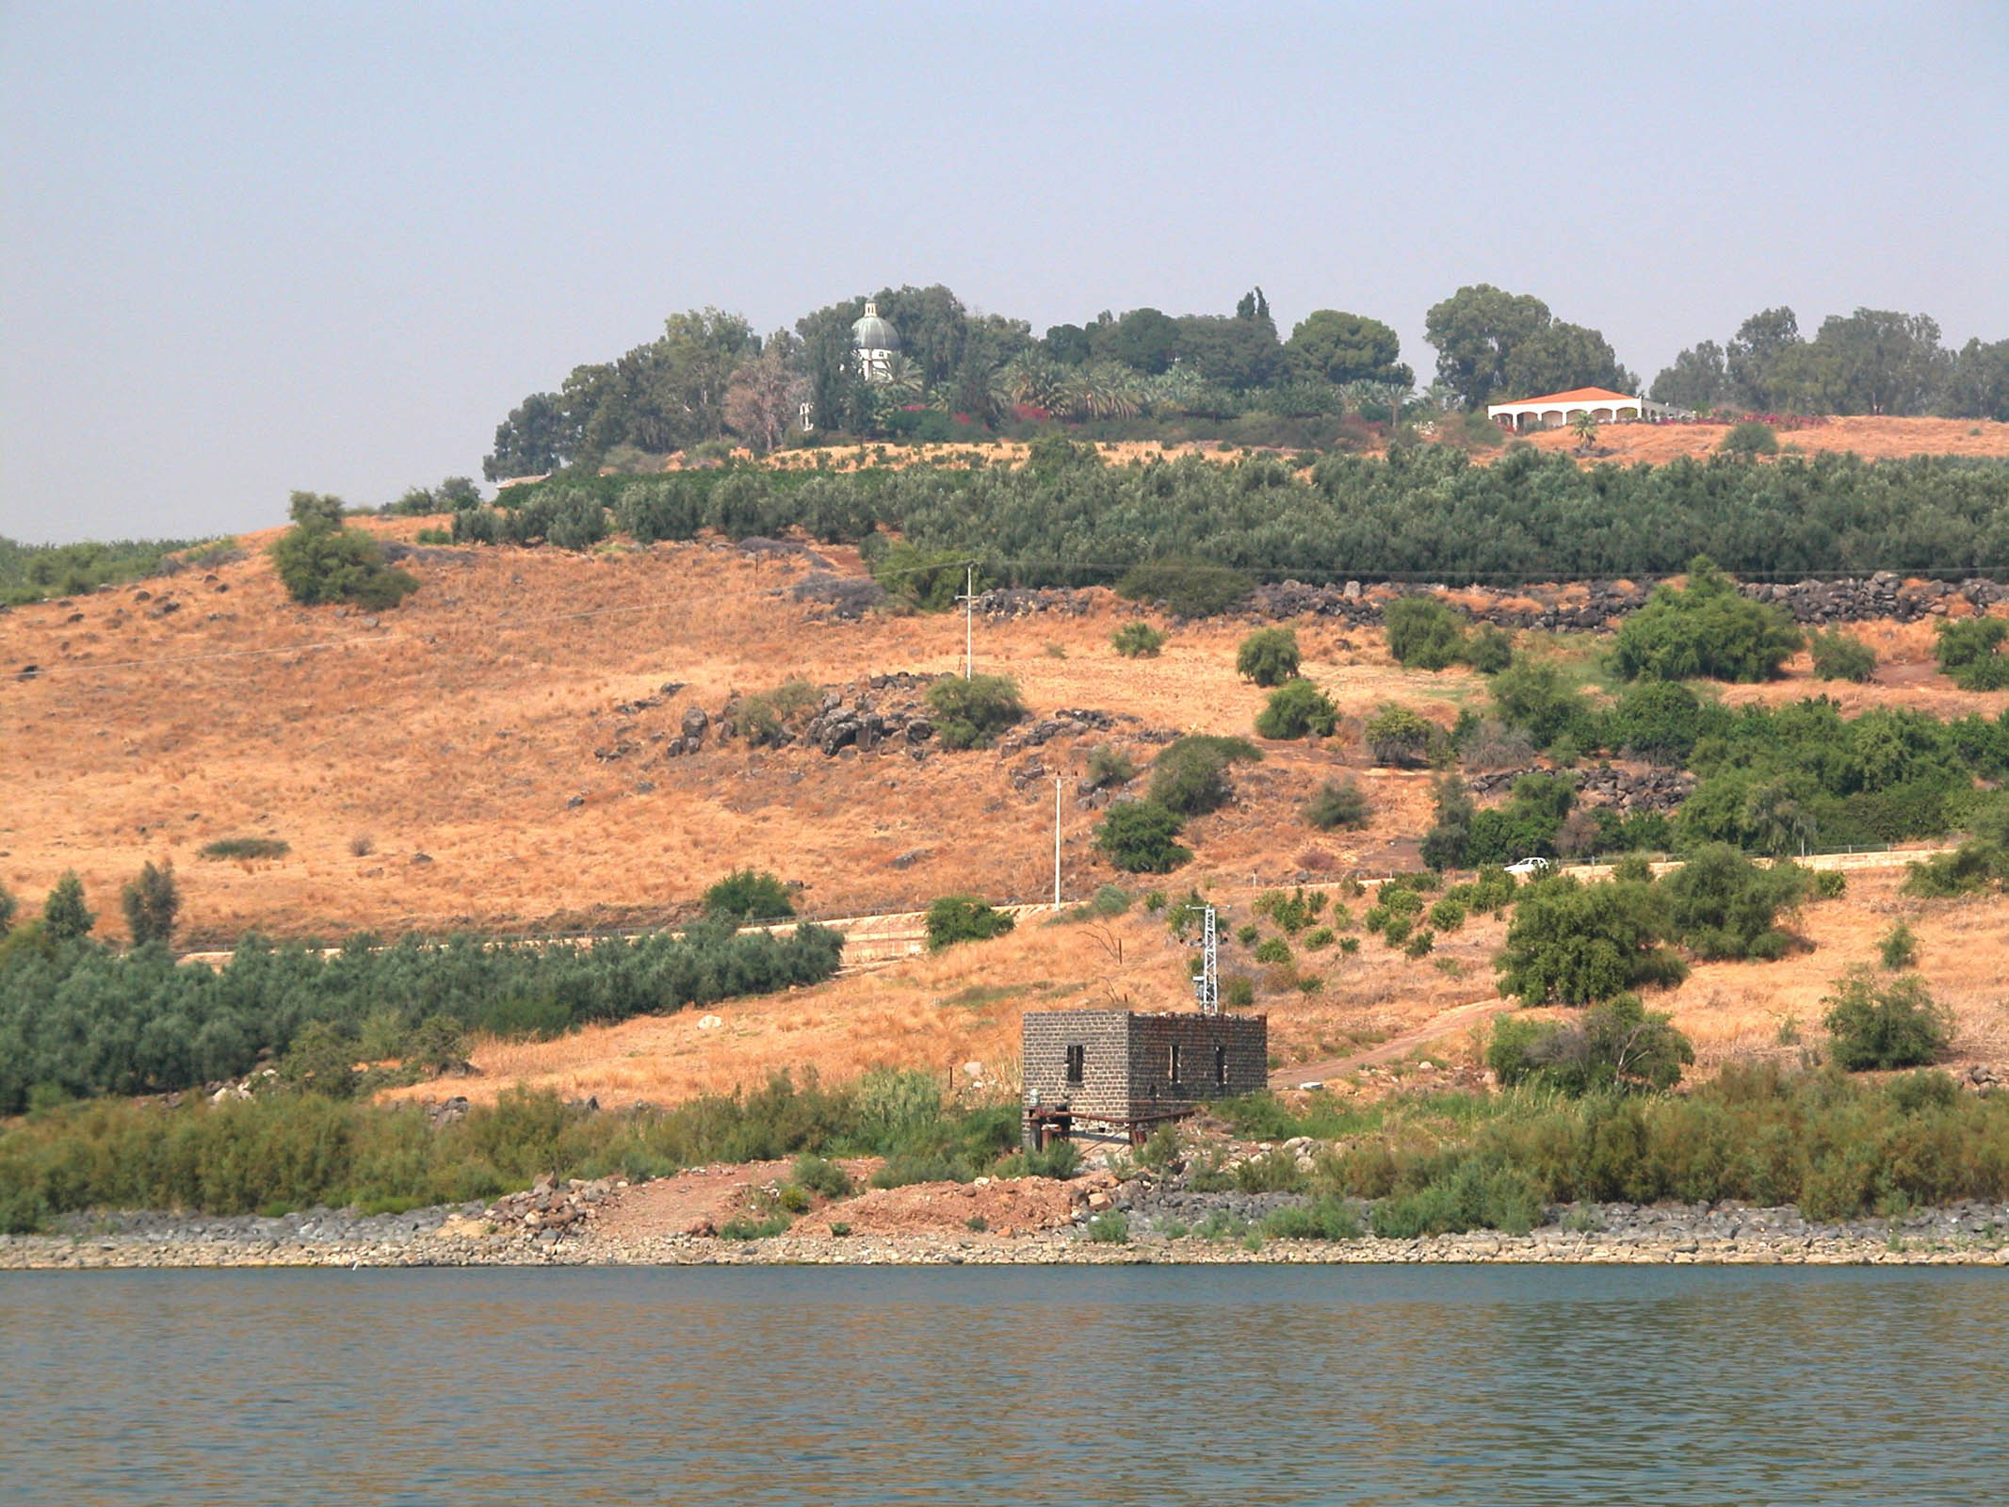
Matthew 6.19-34: Treasure and Provision
Possible site of the Sermon on the Mount and/or Sermon on the Plain, looking north from the Sea of Galilee.
Photo ©2012 Todd Bolen / BiblePlaces.com

Slide 2
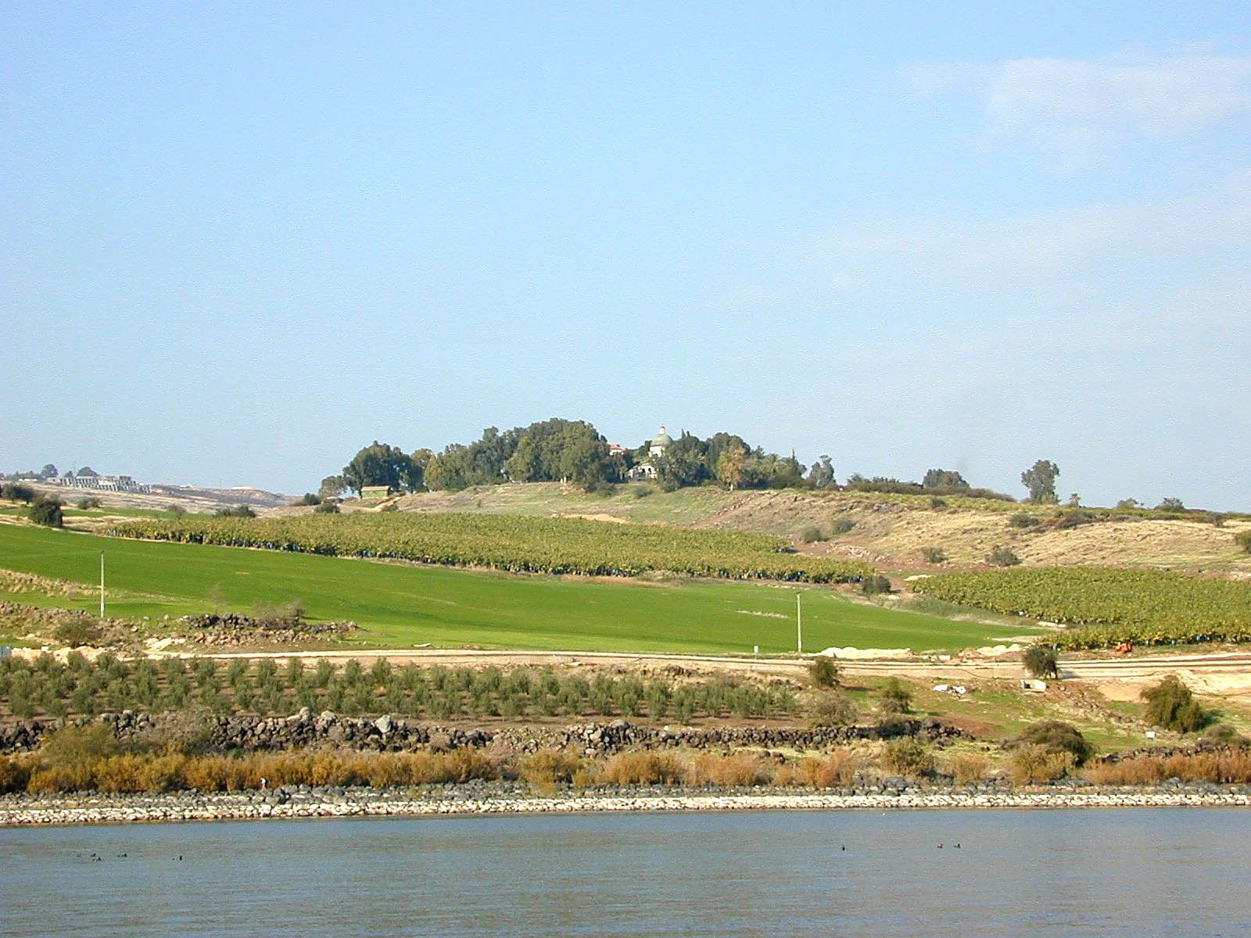
Matthew 6.19-20 ESV: “Do not lay up for yourselves treasures on earth, where moth and rust destroy and where thieves break in and steal, but lay up for yourselves treasures in heaven, where neither moth nor rust destroys and where thieves do not break in and steal.”
Photo ©2012 Todd Bolen / BiblePlaces.com

Slide 3
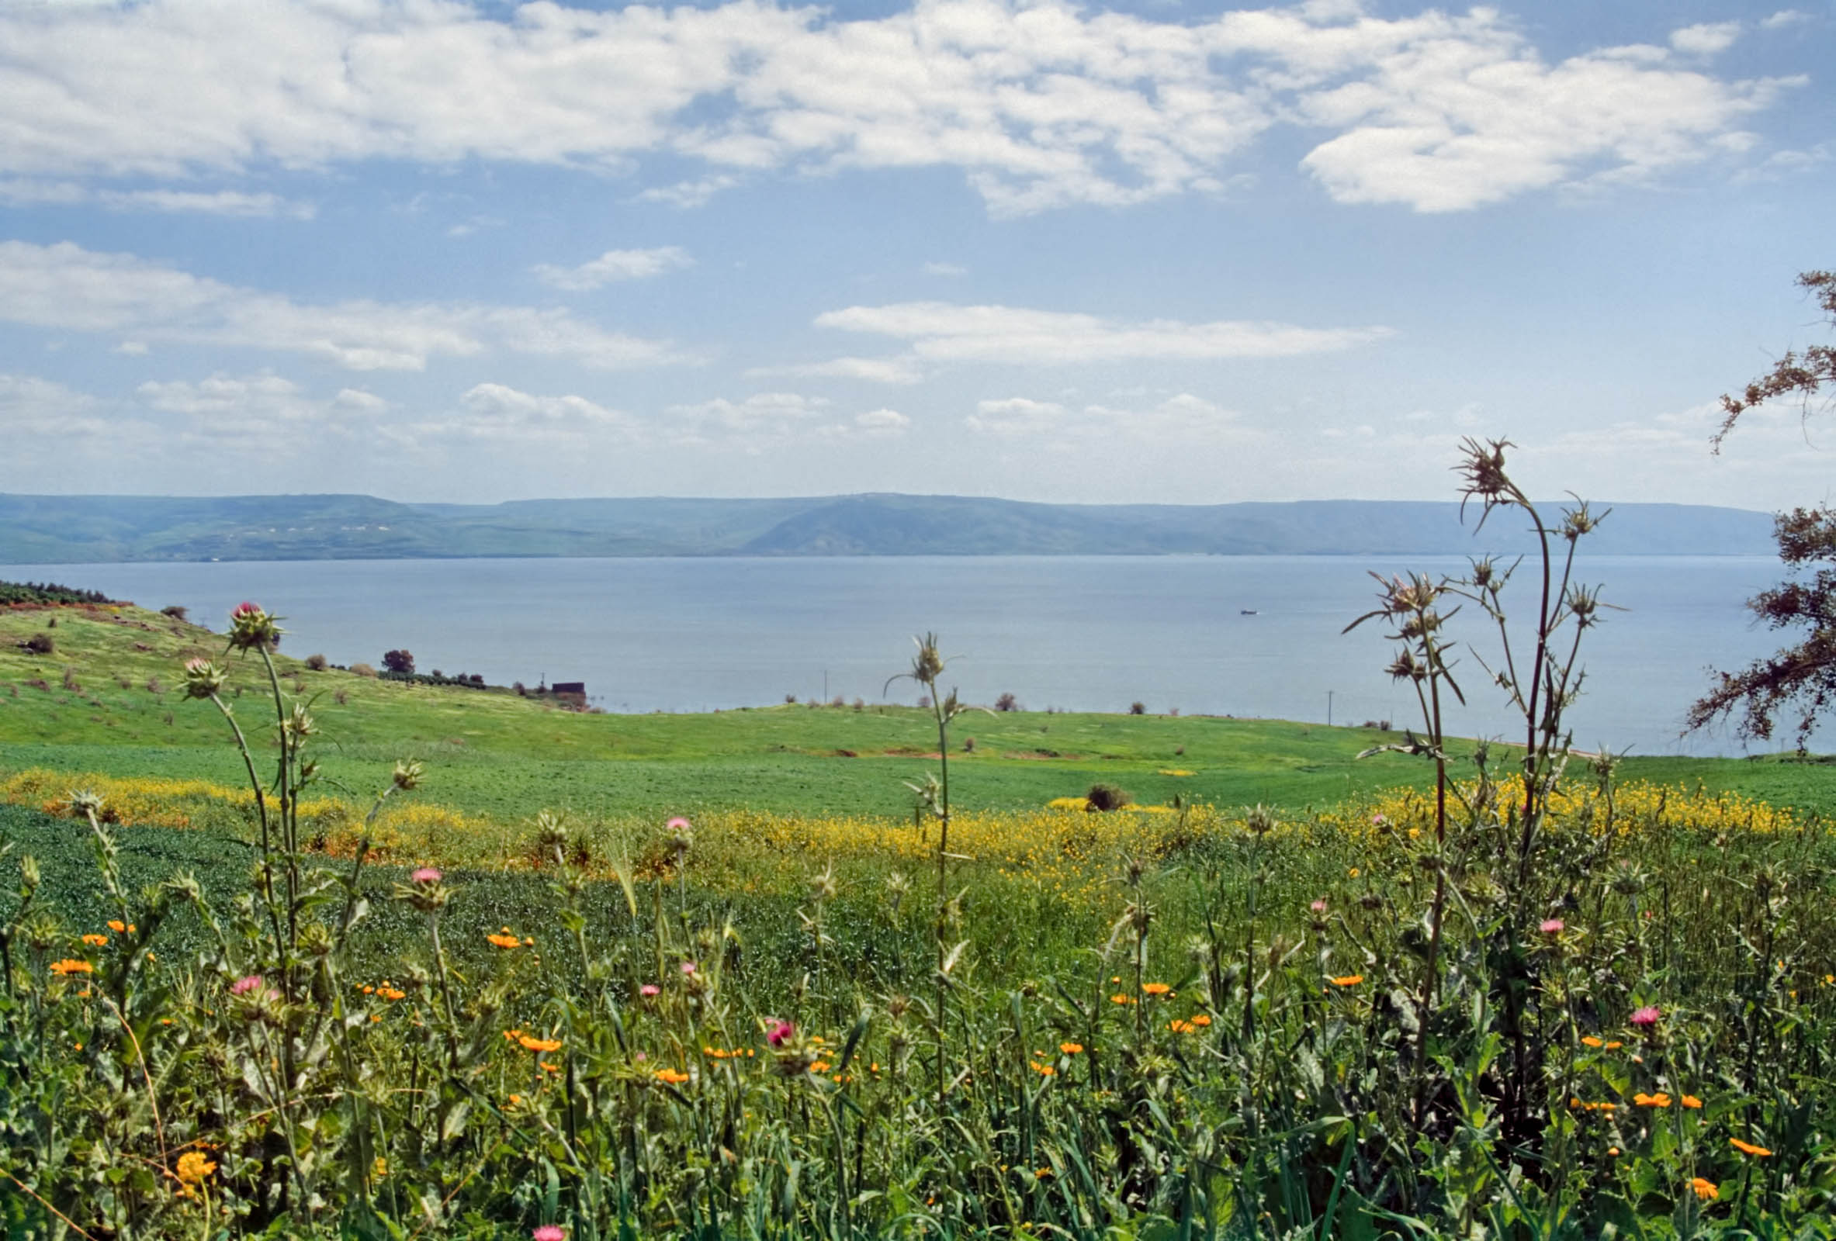
Matthew 6.19: “Do not lay up for yourselves treasures on earth, where moth and rust destroy and where thieves break in and steal.”
things here are temporal and temporary
Looking toward the Sea of Galilee
Photo ©2012 Todd Bolen / BiblePlaces.com

Slide 4
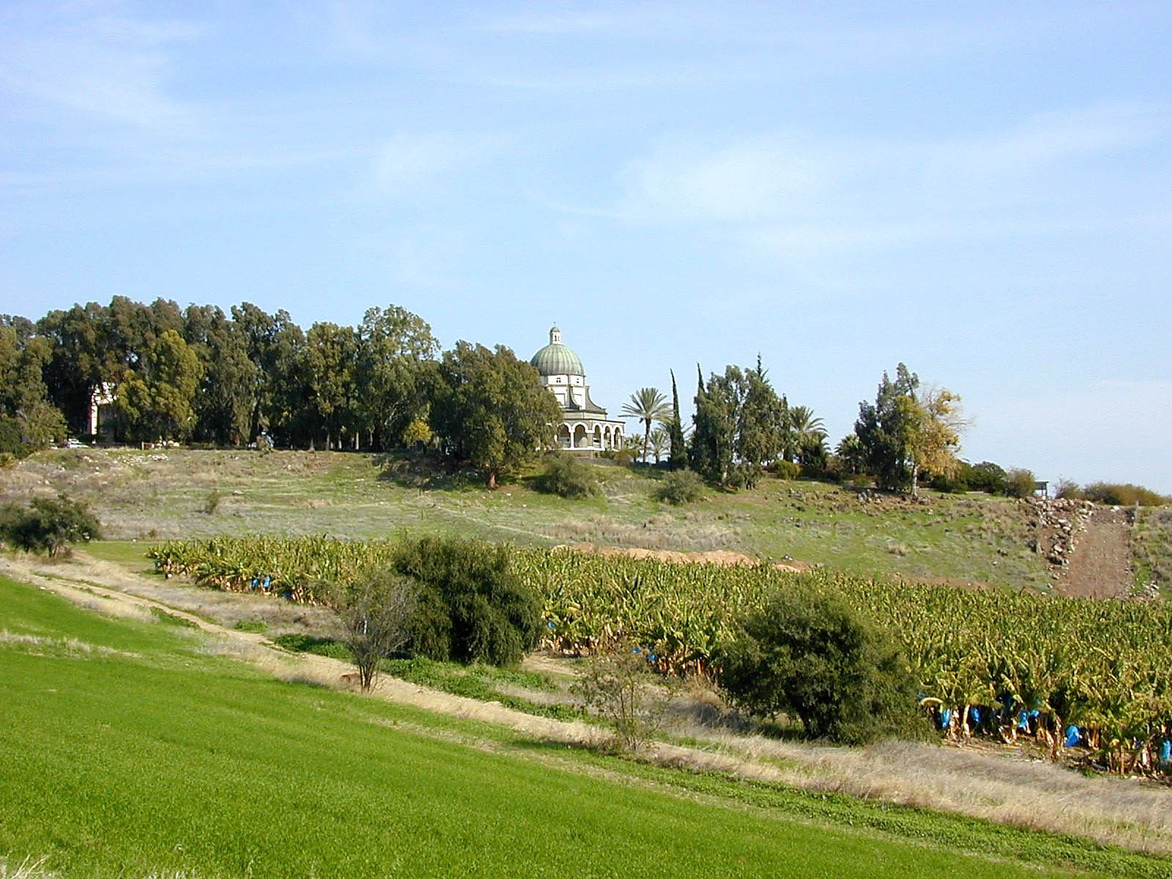
Matthew 6.20: “lay up for yourselves treasures in heaven, where neither moth nor rust destroys, and where thieves do not break in and steal.”
Church on the site financed by Mussolini!
Photo ©2012 Todd Bolen / BiblePlaces.com

Slide 5
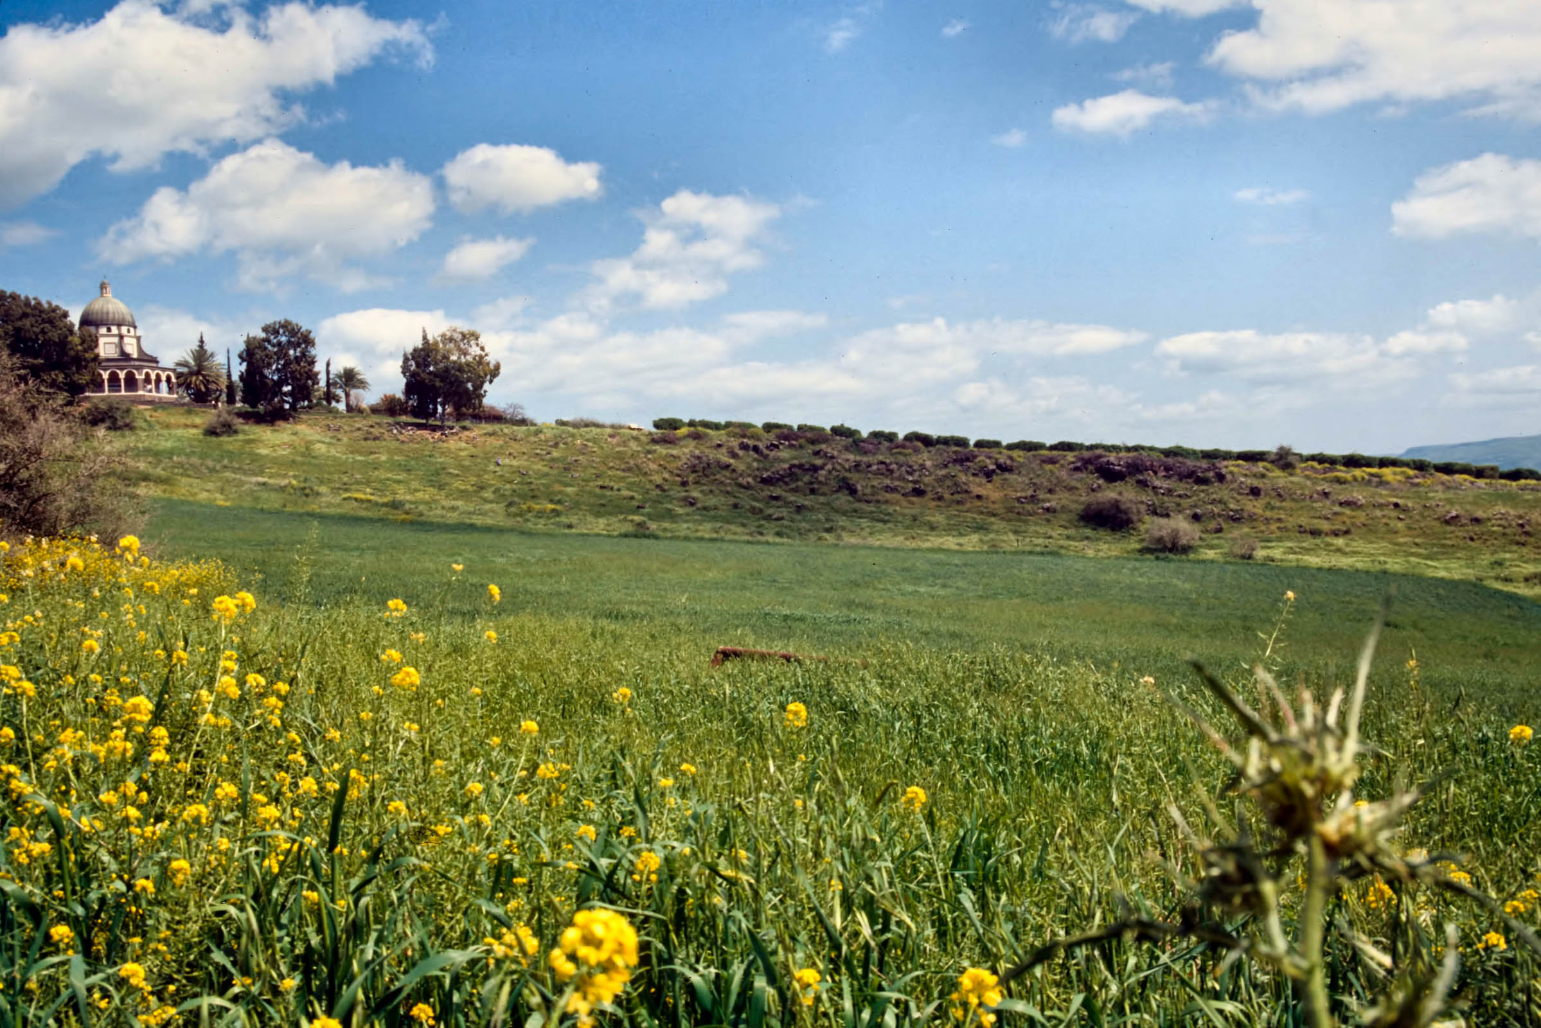
Matthew 6.21: “For where your treasure is,
there your heart will be also.”
Photo ©2012 Todd Bolen / BiblePlaces.com

Slide 6
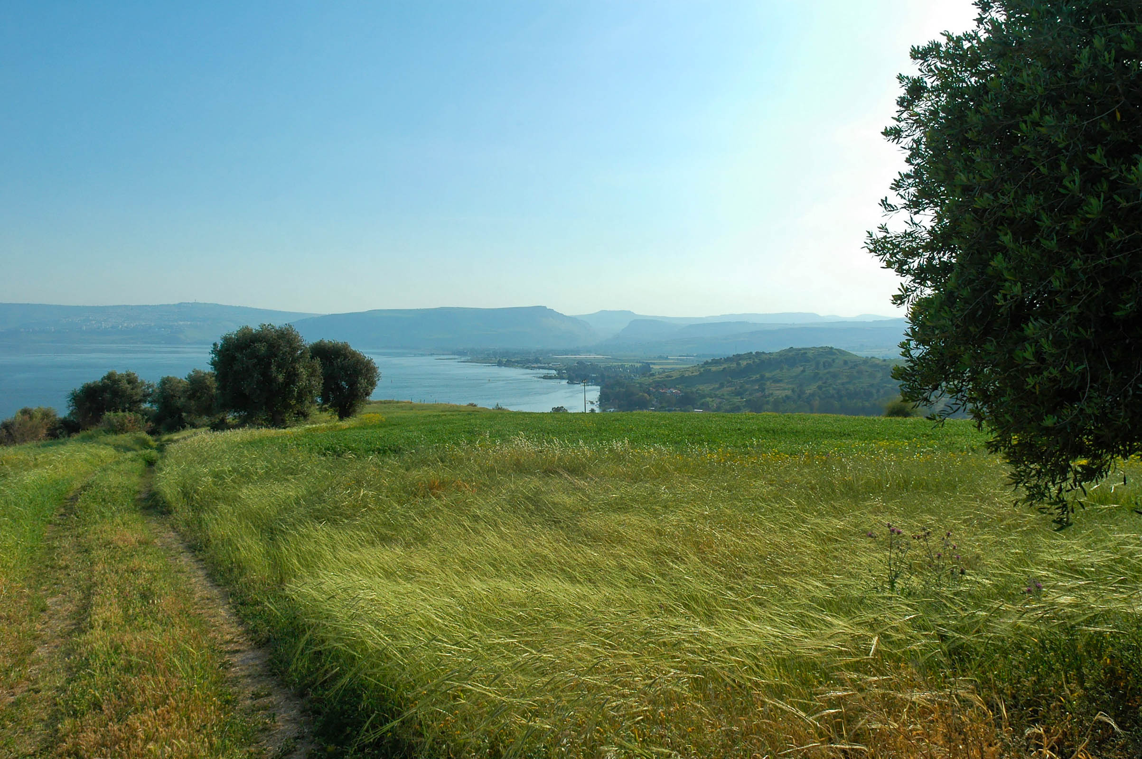
Matthew 6.22-23: “The eye is the lamp of the body. So, if your eye is healthy, your whole body will be full of light, but if your eye is bad, your whole body will be full of darkness. If then the light in you is darkness, how great is the darkness!”
Photo ©2012 Todd Bolen / BiblePlaces.com

Slide 7
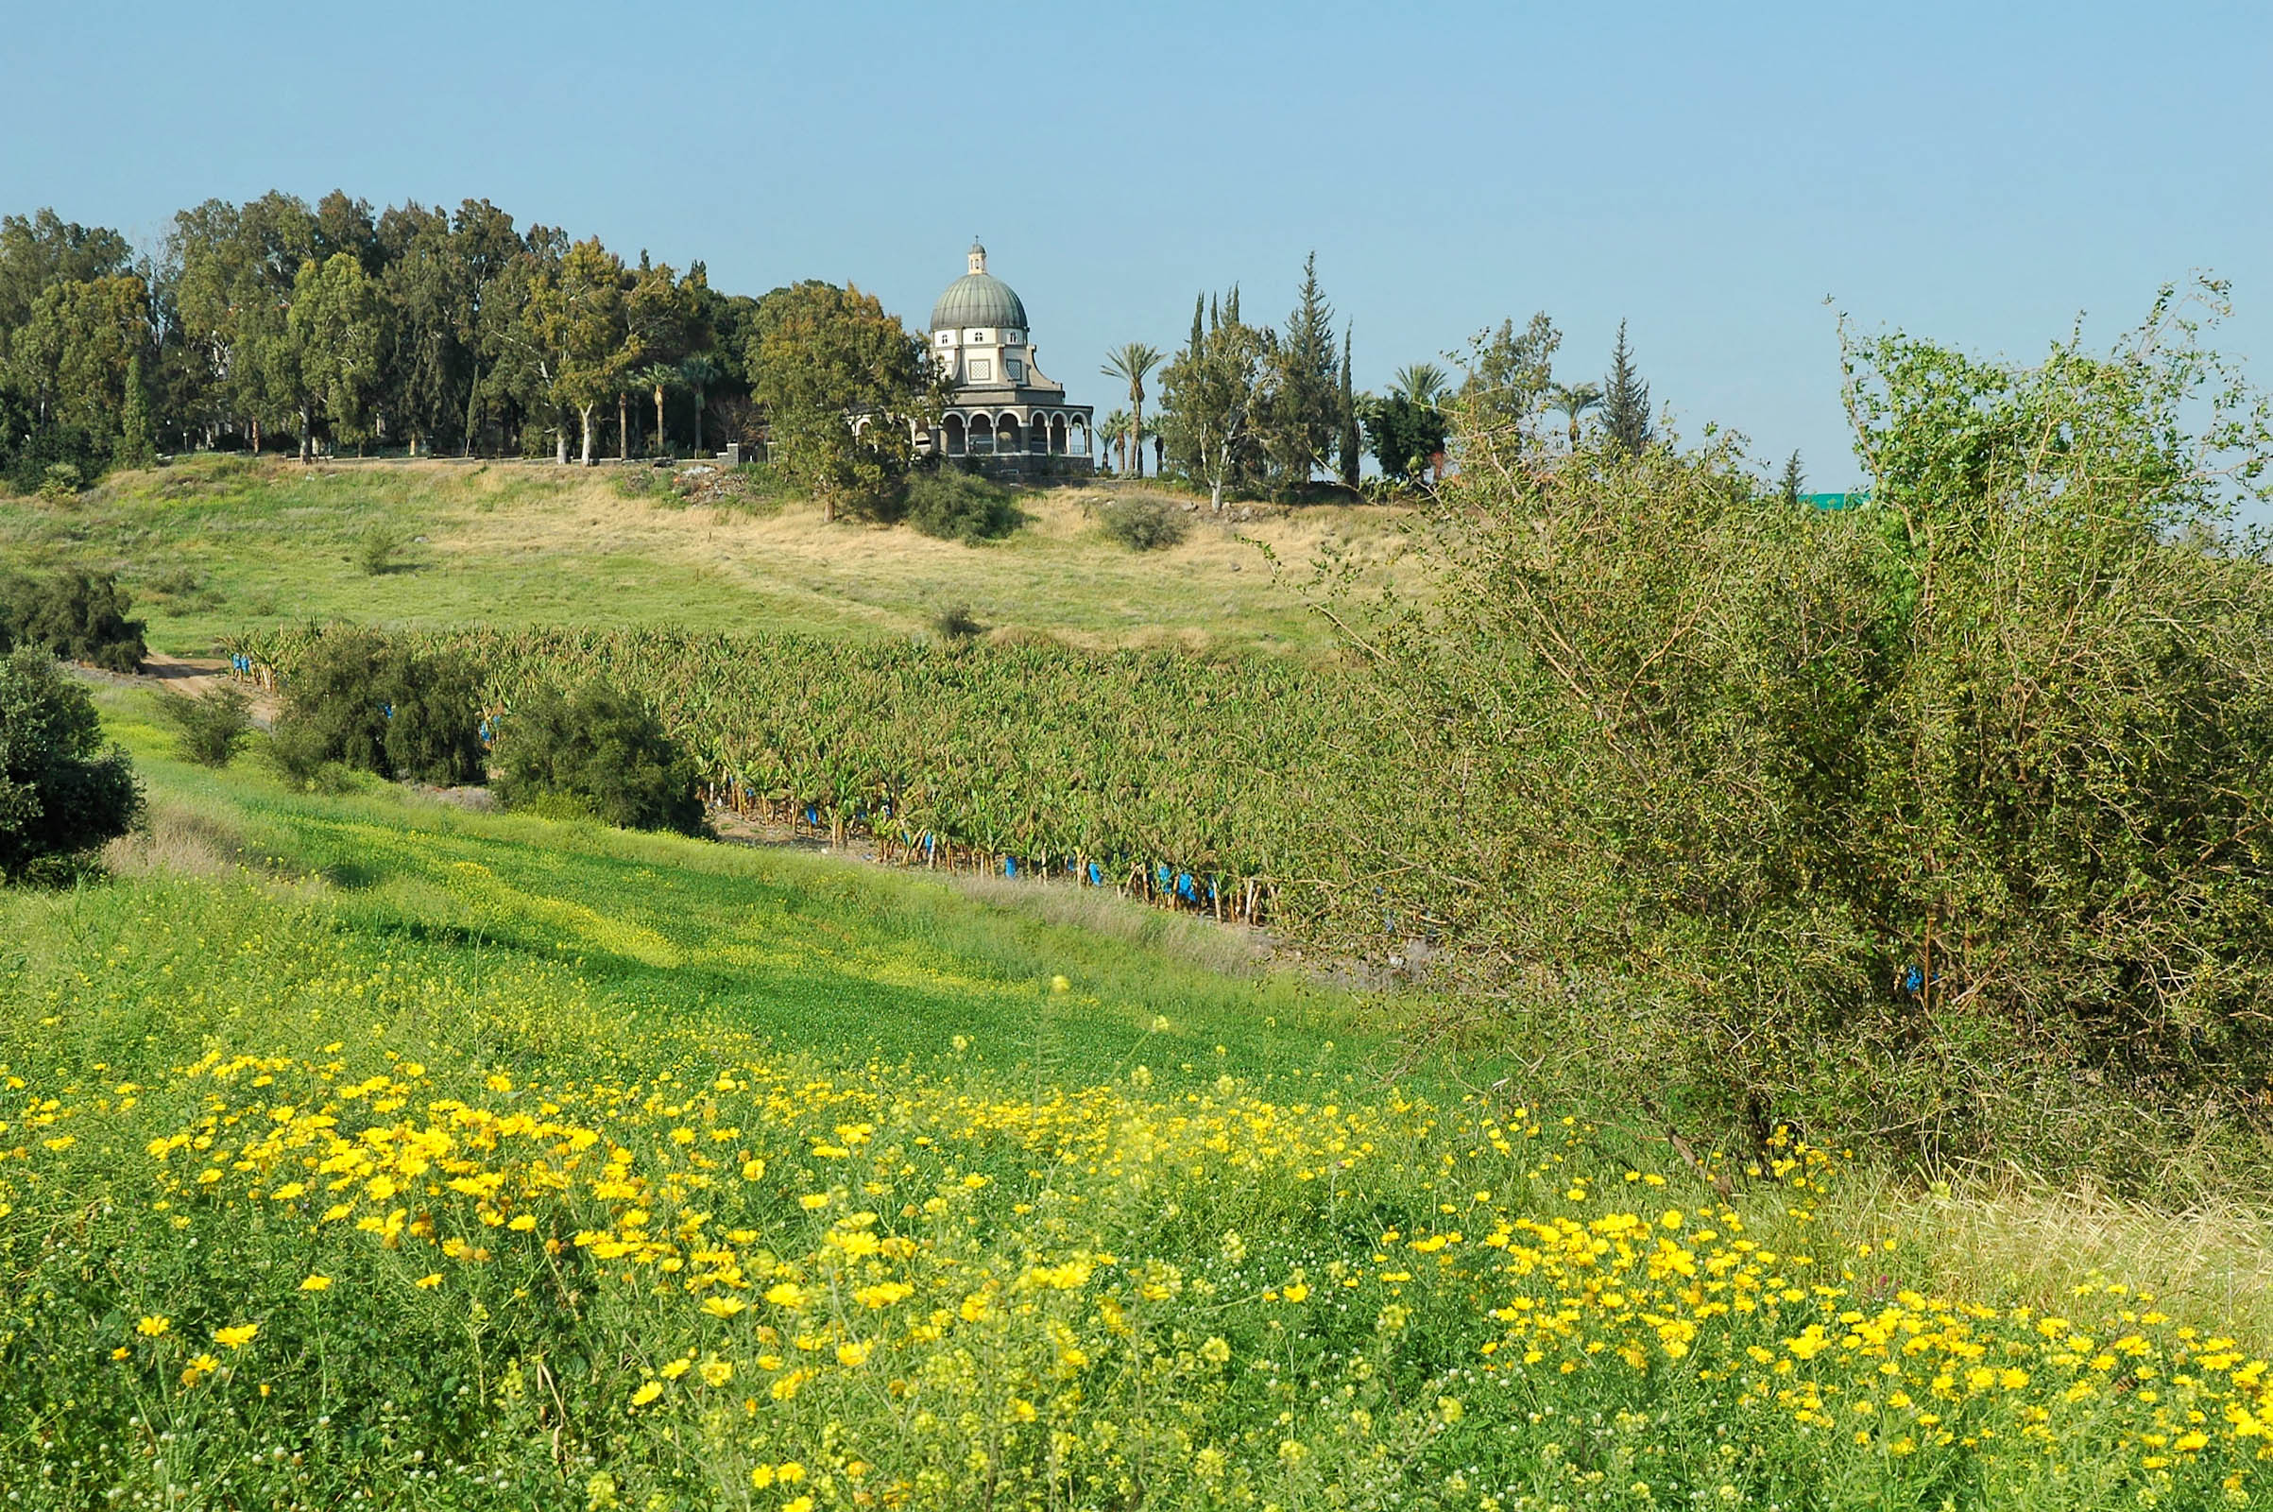
Matthew 6.24: “No one can serve two masters, for either he will hate the one and love the other, or he will be devoted to the one and despise the other. You cannot serve God and money.”
Photo ©2012 Todd Bolen / BiblePlaces.com

Slide 8
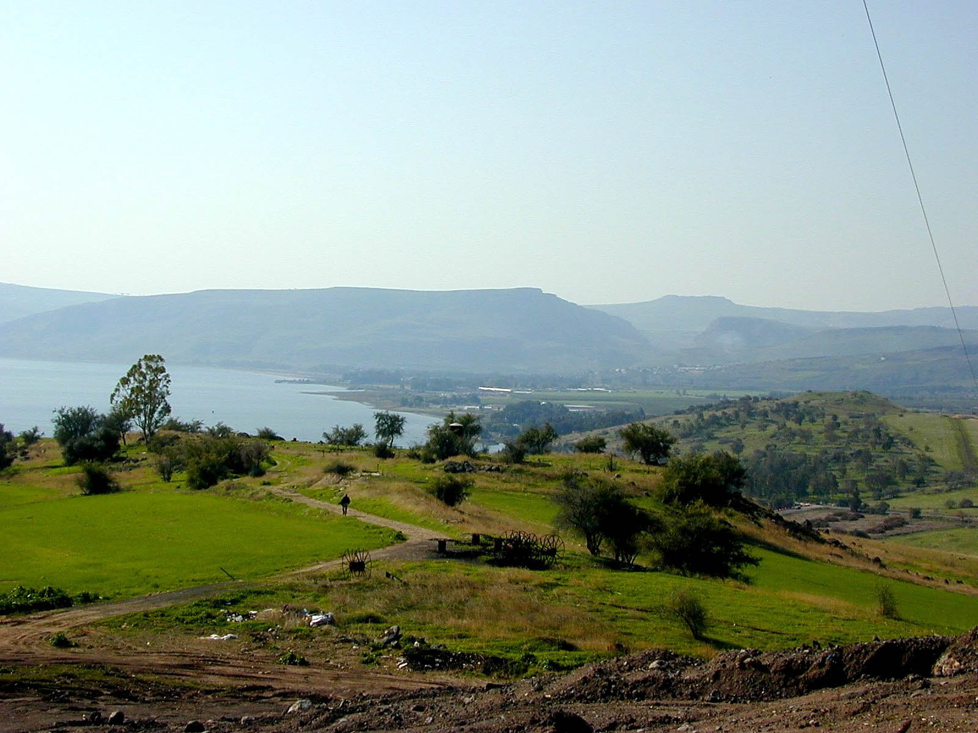
Matthew 6.25-26 ESV: “Therefore I tell you, do not be anxious about your life, what you will eat or what you will drink, nor about your body, what you will put on. Is not life more than food, and the body more than clothing? Look at the birds of the air: they neither sow nor reap nor gather into barns, and yet your heavenly Father feeds them. Are you not of more value than they?”
Photo ©2012 Todd Bolen / BiblePlaces.com

Slide 9
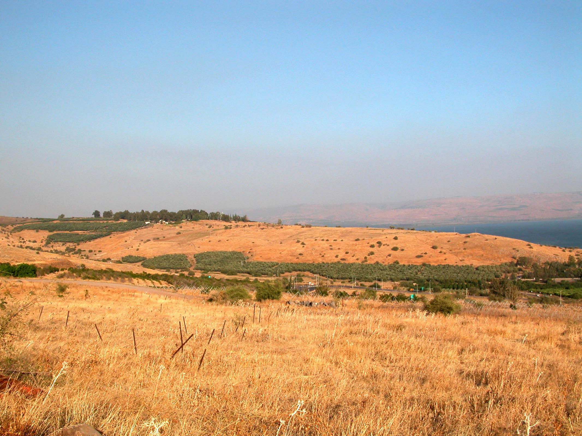
Matthew 6.27-30 ESV: “And which of you by being anxious can add a single hour to his span of life? And why are you anxious about clothing? Consider the lilies of the field, how they grow: they neither toil nor spin, yet I tell you, even Solomon in all his glory was not arrayed like one of these. But if God so clothes the grass of the field, which today is alive and tomorrow is thrown into the oven, will he not much more clothe you, O you of little faith?”
Photo ©2012 Todd Bolen / BiblePlaces.com

Slide 10
Matthew 6.31-34 ESV: “Therefore do not be anxious, saying, ‘What shall we eat?’ or ‘What shall we drink?’ or ‘What shall we wear?’ For the Gentiles seek after all these things, and your heavenly Father knows that you need them all. But seek first the kingdom of God and his righteousness, and all these things will be added to you. Therefore do not be anxious about tomorrow, for tomorrow will be anxious for itself. Sufficient for the day is its own trouble.”
Photo ©2012 Todd Bolen / BiblePlaces.com

Slide 11
Matthew 6.33: “But seek first the kingdom of God and his righteousness, and all these things will be added to you.”
Photo ©2012 Todd Bolen / BiblePlaces.com

Slide 12
Matthew 6.33: “But seek first the kingdom of God and his righteousness, and all these things will be added to you.”
Photo ©2012 Todd Bolen / BiblePlaces.com

Slide 13
Matthew 6.33: “But seek first the kingdom of God and his righteousness, and all these things will be added to you.”
Photo ©2012 Todd Bolen / BiblePlaces.com

